Slide 1
Machine Learning for Text Extraction

Slide 2

First a story:
I was driving the husband’s car in Denver, and tires spun on a small patch of ice
I decided “I have 4WD, why not see if it helps”.
It didn’t.
Reversed car out of icy spot and the power steering went out.

Slide 3
Is there a connection between power steering and 4 wheel drive?
Downloaded the nearly 500 page users manual to check for a connection.
Used a machine learning model to parse out the 7,000 sentences in the document and identify every noun. (also did subject-> object relationships).
Created a separate pair for every noun pair

Slide 4
Extract nouns and identify relationships
“If your vehicle does not have four-wheel drive, you should not drive off-road unless you are on a level, solid surface”
Noun | Noun2
vehicle | drive
vehicle | off-road
vehicle | surface
drive | off-road
drive | surface
off-road | surface

Slide 5
Graph Relationships
vehicle
drive
off -road
surface

Slide 6
Graph relationships for all sentences
“If your vehicle does not have four-wheel drive, you should not drive off-road unless you are on a level, solid surface.”
“Each of these surfaces affects the steering, acceleration and braking of your vehicle in different ways”.
vehicle
ways
breaking
drive
off -road
acceleration
surface
steering

Slide 7
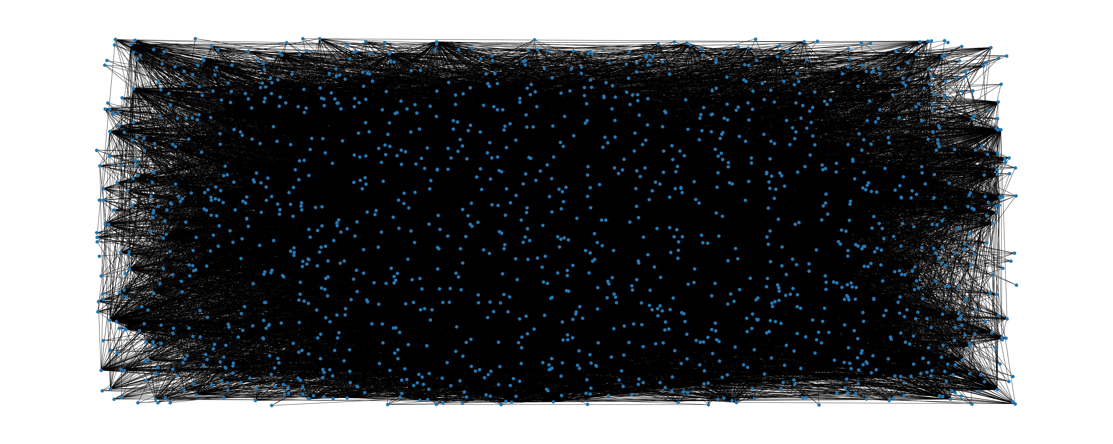
Reality: 1,558 nodes 27,017 edges

Slide 8
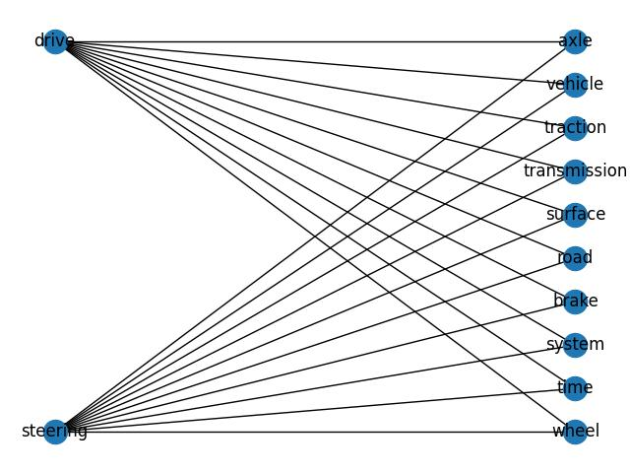
Network Analysis: Shortest Paths

Slide 9

Good News!
There is no direct connection between 4 Wheel Drive and Power Steering.

Slide 10
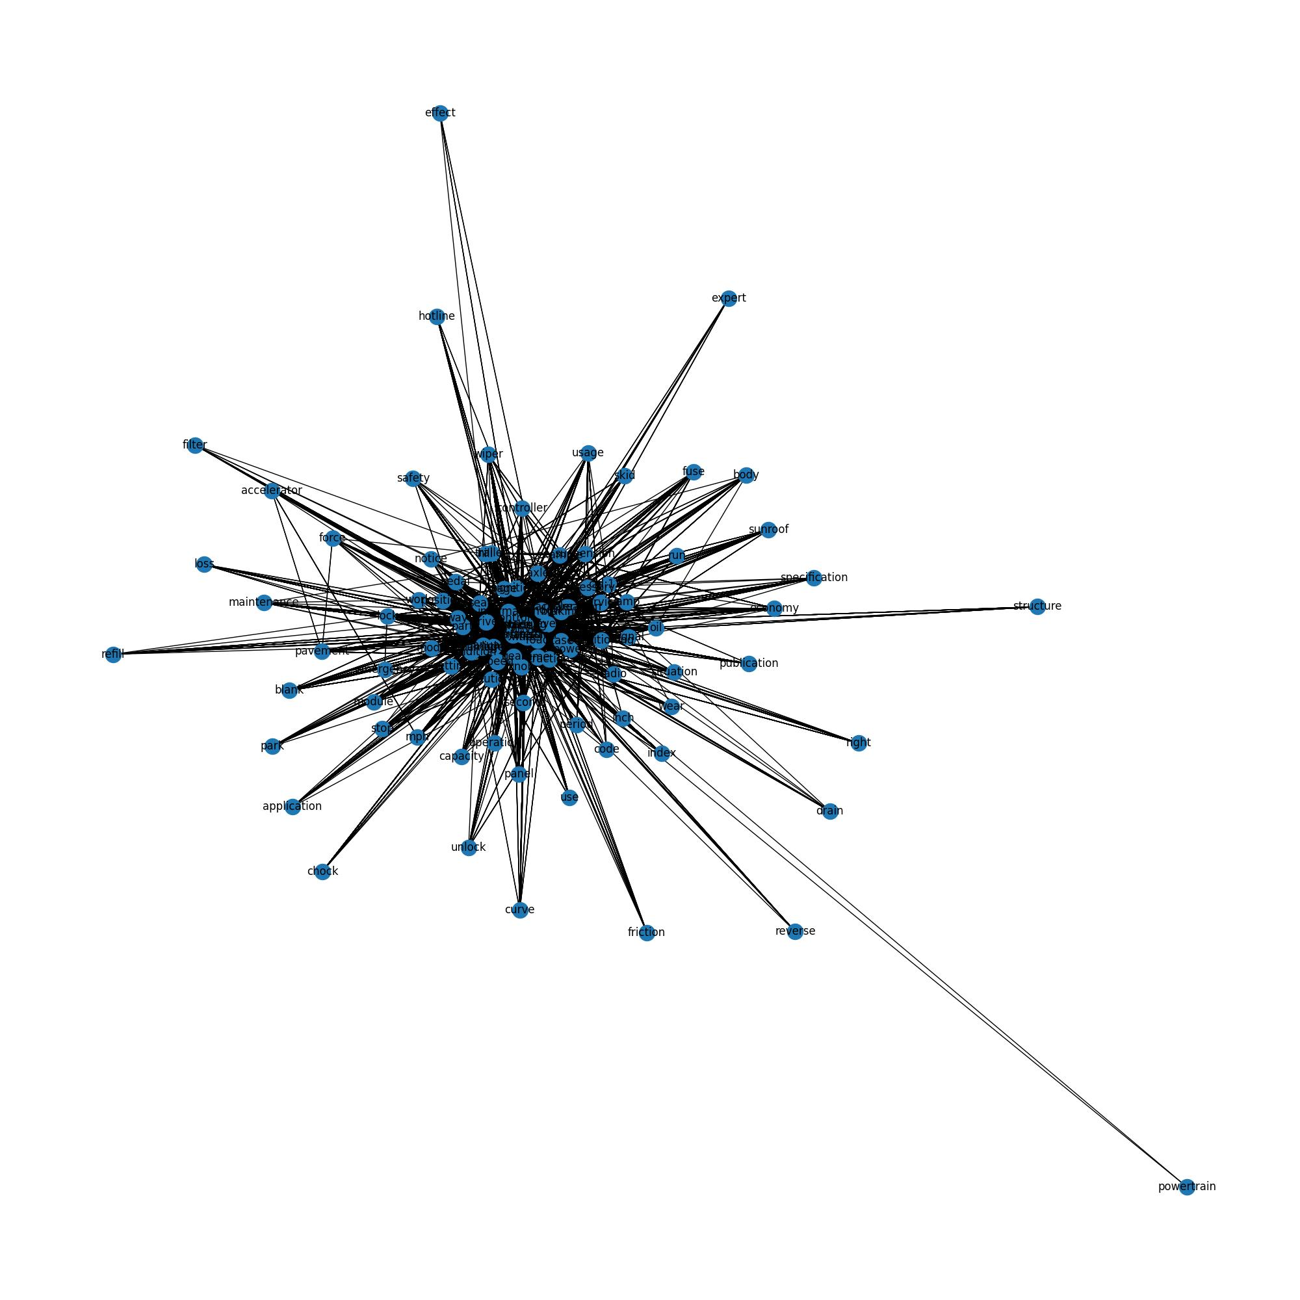
Network Analysis: All Paths (up to 2 connecting nodes)
Source | Connection 1 | Connection 2 | Target
steering | acceleration | surface | drive
steering | brake | lever | drive
steering | control | traction | drive
steering | tire | hill | drive

Slide 11
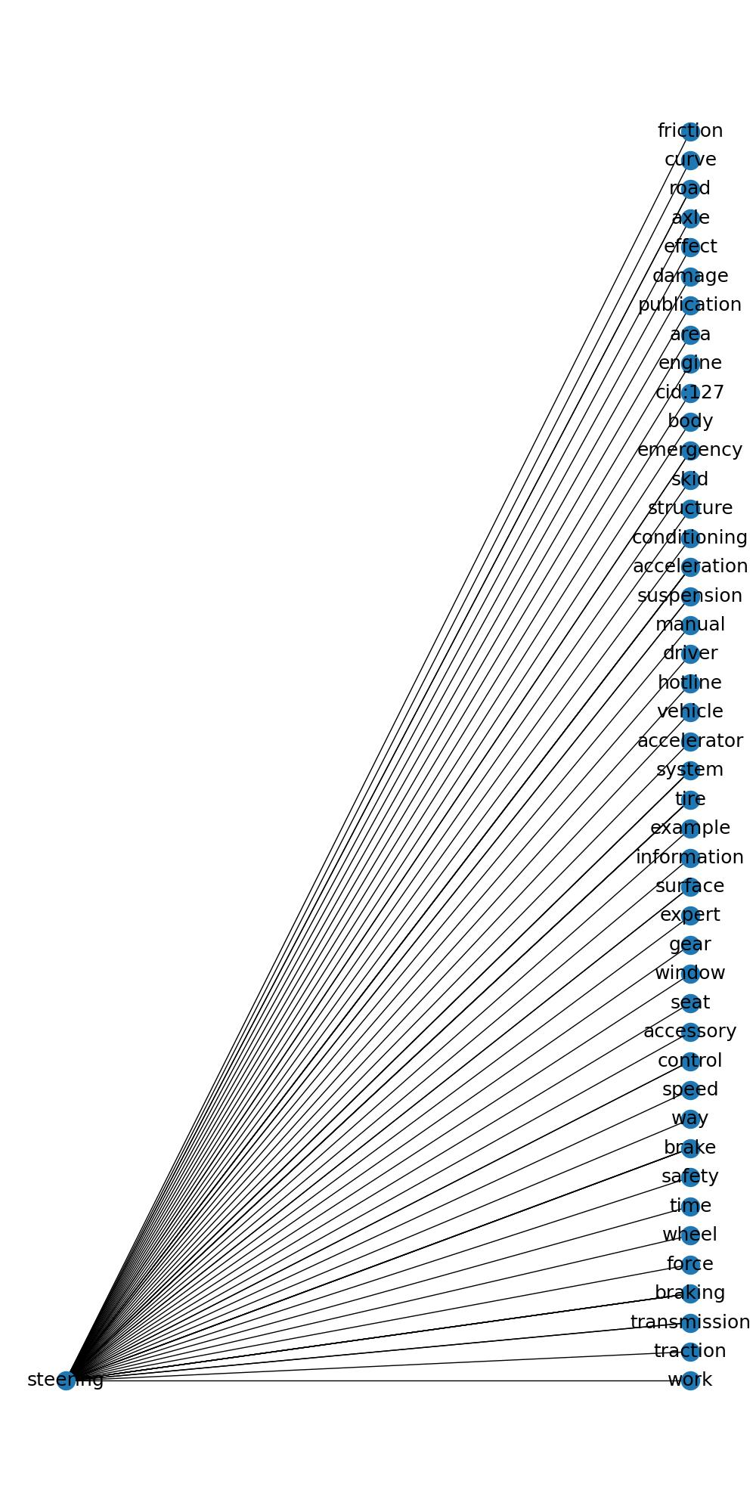
What else is connected to power steering?

Slide 12
So what?

Slide 13
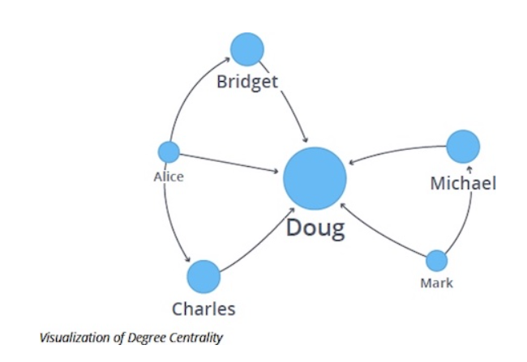
A VERY brief foray into graph theory
Centrality:
How important is a given node to the entire graph.
Degree Centrality:
How well connected is each node to every other node?

Slide 14
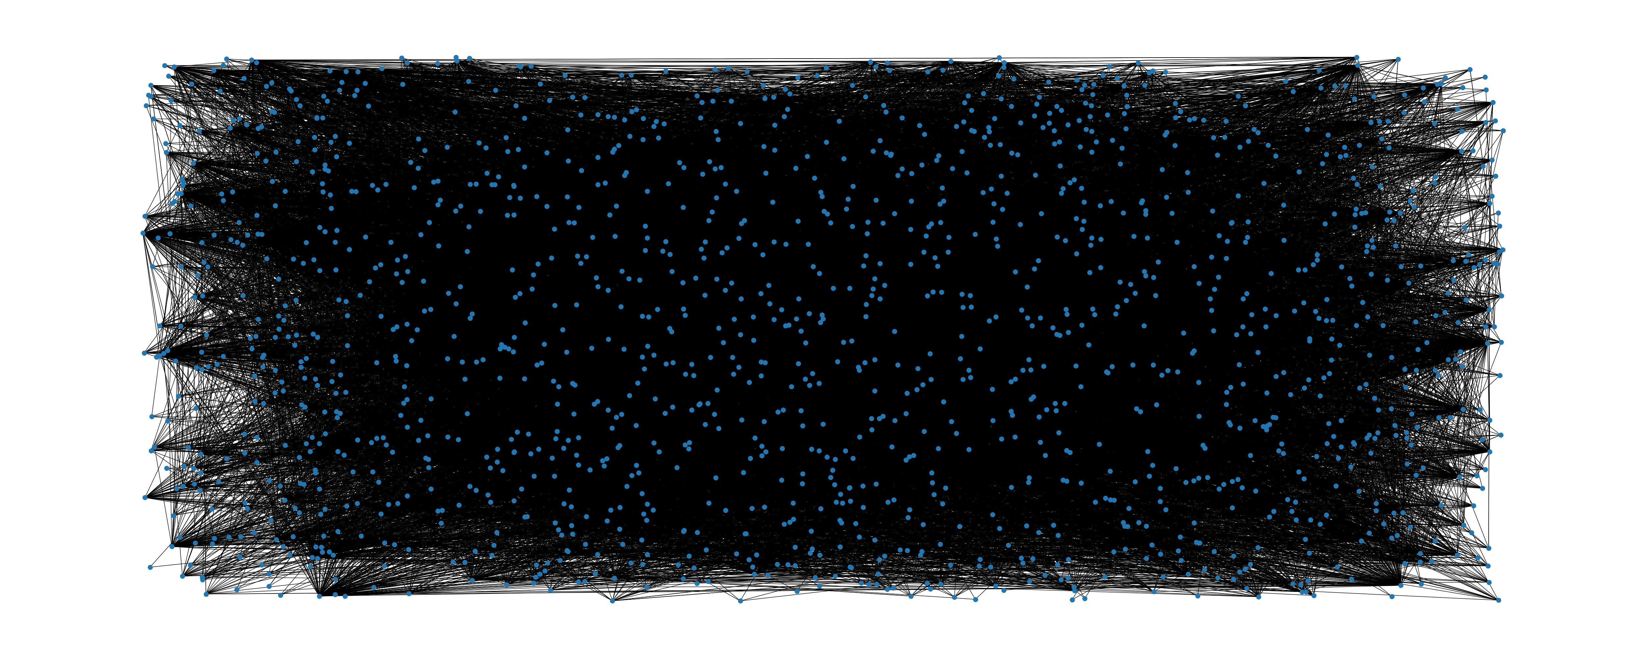
Most important nodes (whole graph):
If you want to cause the most damage to a car, mess with the tires.
The tires are extremely important in the overall system of the vehicle.
The engine is a close second.
If you want to cause the most damage to a car, mess with the tires.
Need SME interpretation.
Node | Degree Centrality | N Neighbors
vehicle | 1.782274 | 687
system | 0.657033 | 347
button | 0.535645 | 227
tire | 0.396275 | 253
engine | 0.322415 | 223
position | 0.282595 | 177
display | 0.281310 | 130
information | 0.278741 | 199
control | 0.267823 | 198
light | 0.262042 | 169

Slide 15
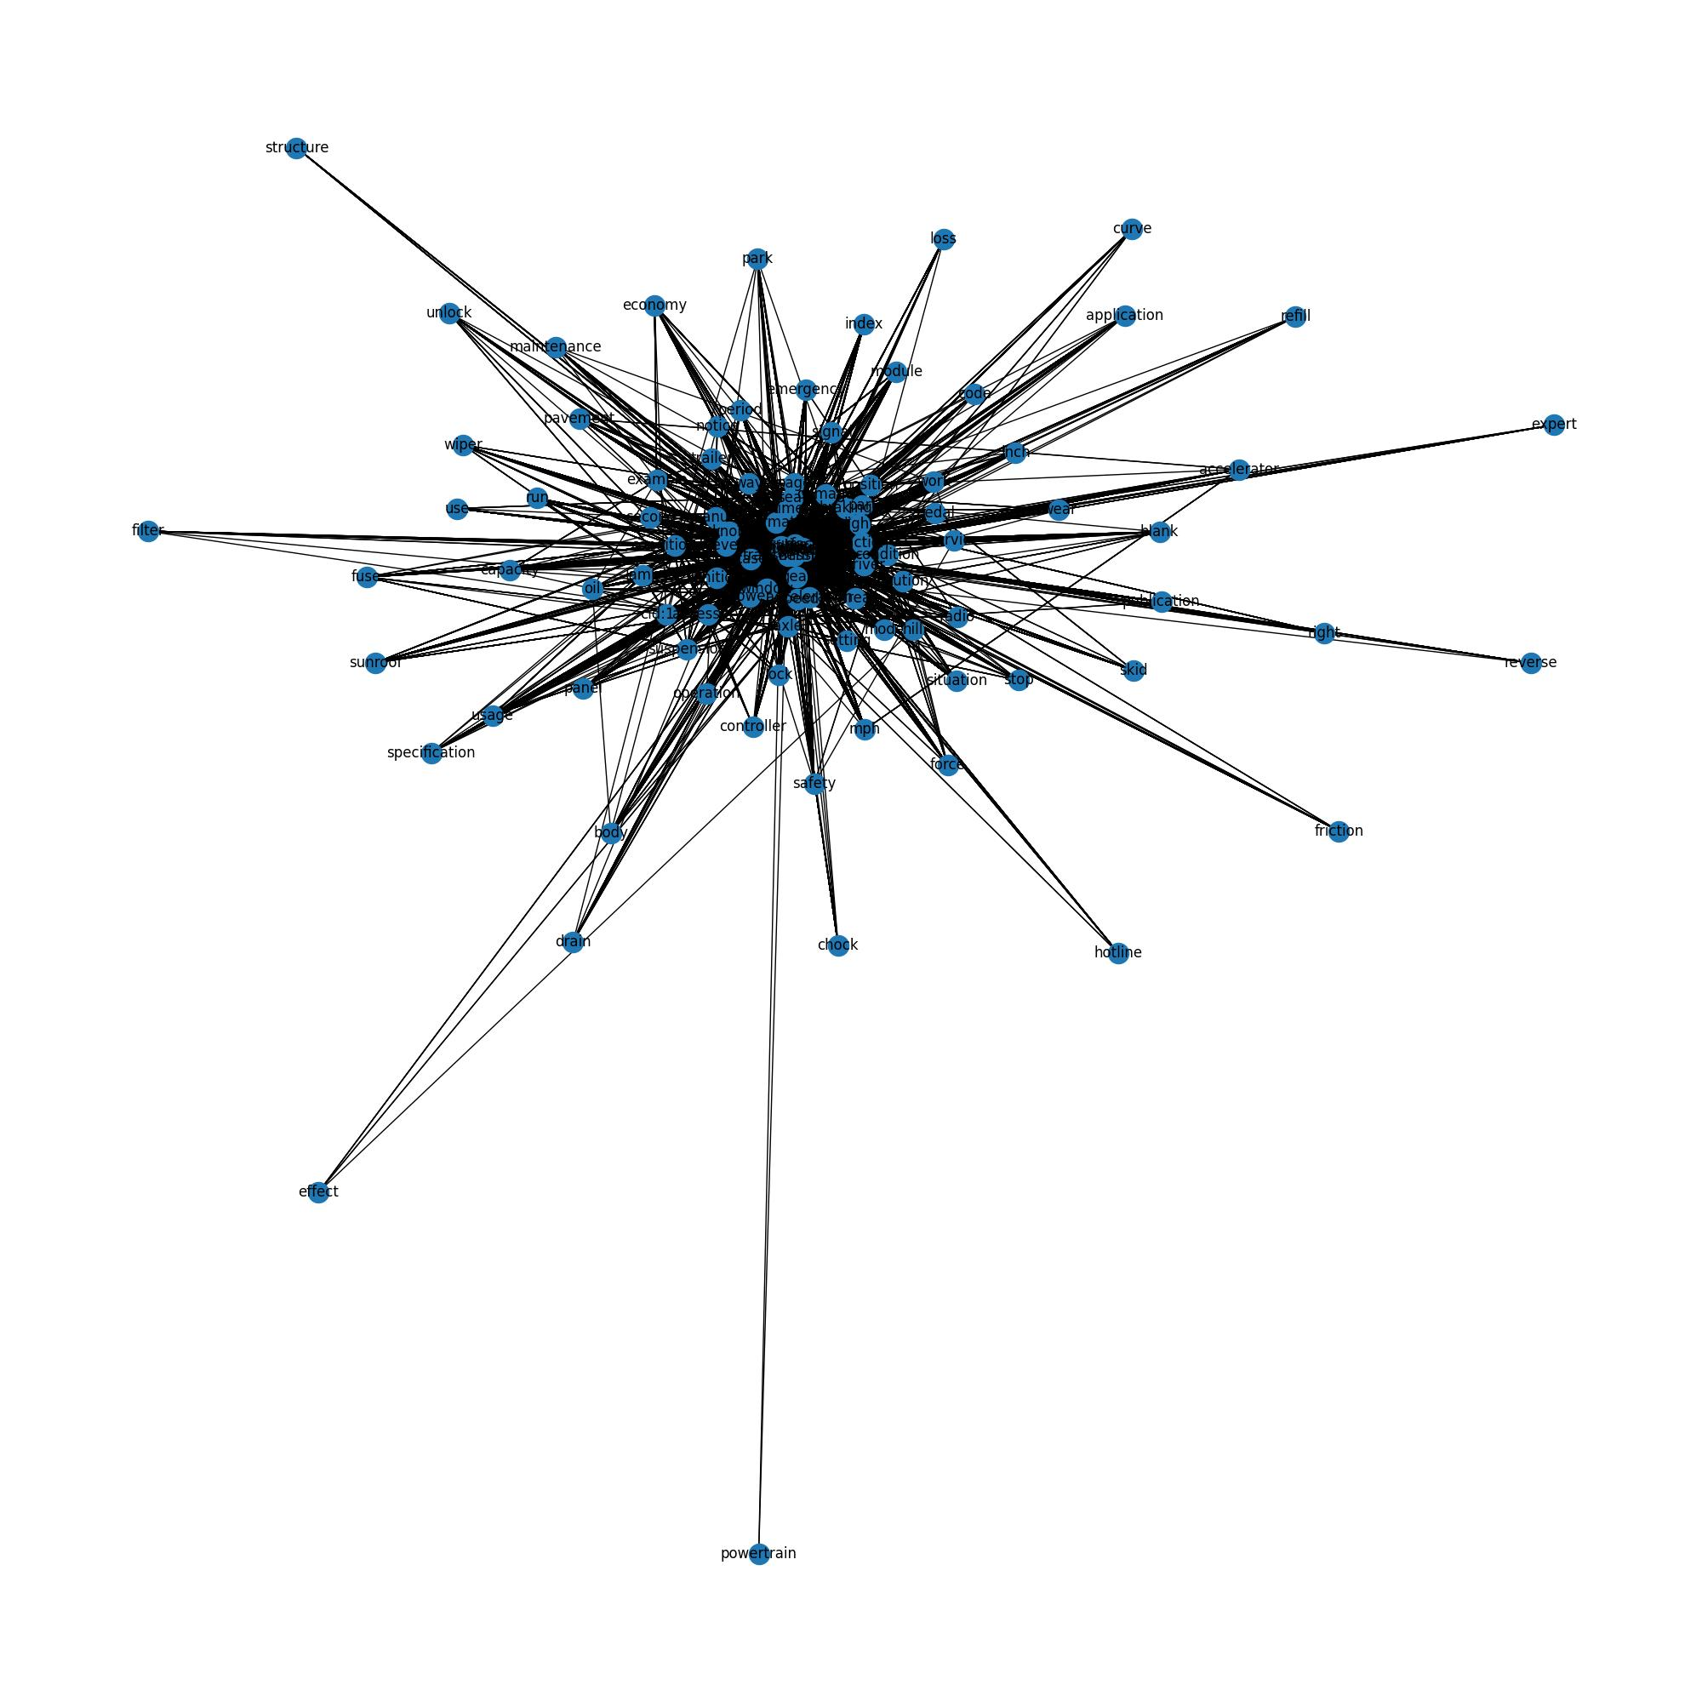
Most Important Nodes (Steering->Drive)
Tires and engine are still an extremely important connection point
However, now we have the addition of the transmission, wheels and road.
There is not a strong connection between power steering and four-wheel drive.
Node | Degree Centrality | N Neighbors
vehicle | 8431.635 | 88
system | 3211.096 | 86
drive | 2798.212 | 74
tire | 1340.692 | 33
brake | 994.7115 | 83
steering | 823.5385 | 44
engine | 422.9327 | 77
transmission | 324.2308 | 71
wheel | 274.1923 | 46
road | 192.8654 | 41

Slide 16
Most Important Nodes (Steering)
Node | Degree Centrality | N Neighbors
steering | 1.477273 | 44
braking | 0.113636 | 1
tire | 0.090909 | 1
brake | 0.090909 | 1
acceleration | 0.090909 | 1
system | 0.068182 | 1
surface | 0.045455 | 1
transmission | 0.045455 | 1
emergency | 0.045455 | 1
suspension | 0.045455 | 1
If we only look at the nodes that are direction connected to steering.
Braking is the most important thing connected to steering.

